Slide 1
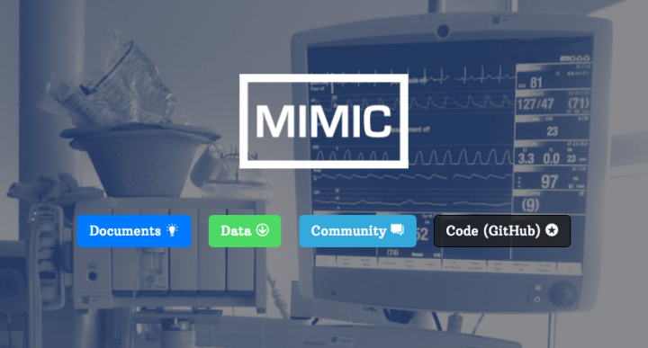
Python Benchmarks for MIMIC-III ("Public Benchmarks for Machine Learning Researchers in Health Care" )
Hrayr Harutyunyan, Hrant Khachatrian, David C. Kale, Greg Ver Steeg, and Aram Galstyan. Multitask Learning and Benchmarking with Clinical Time Series Data.
Patricia Whitley
HMI 7450
Professor Dominic Thomas

